Slide 1
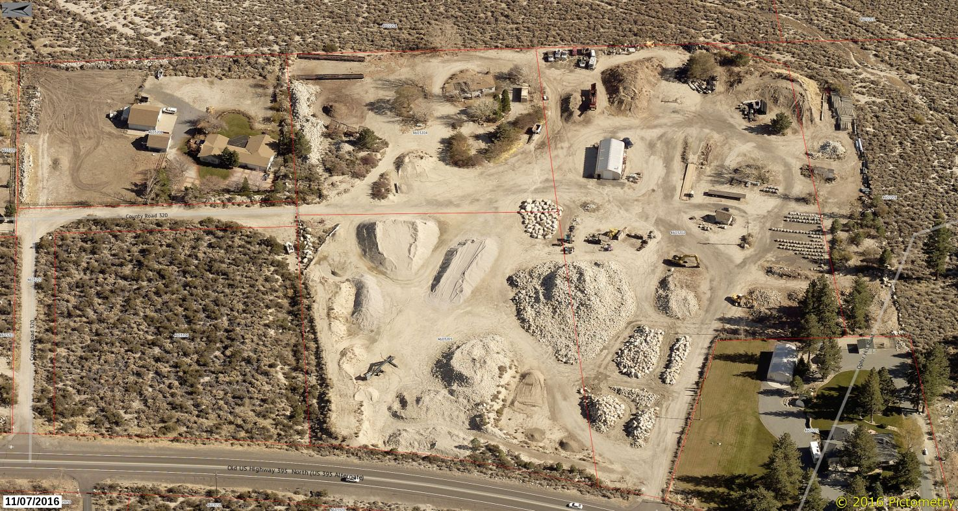
WSUP16-0001 (Ophir Hill)
Washoe County Board of Adjustment
February 2, 2017

Slide 2
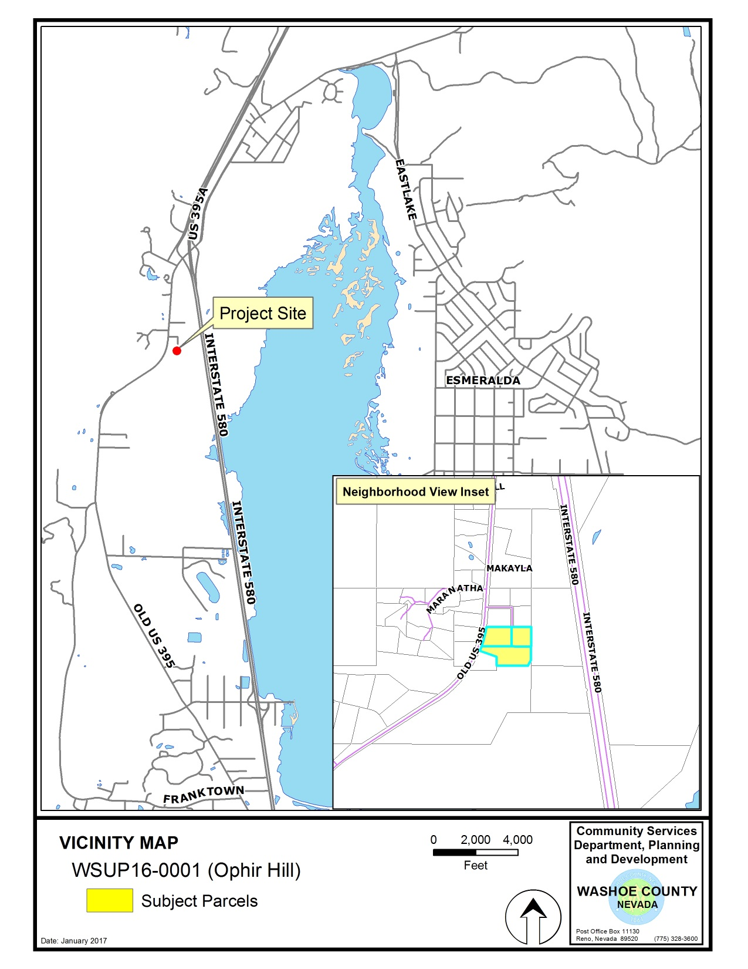

Slide 3
Background
The subject site consists of 3 parcels totaling 11.35-acres, all of which has been disturbed
The parcels are zoned High Density Rural (HDR) and have a Rural Master Plan designation
Adjacent parcels have the same zoning and master plan designations (GR BLM to the east)
Surrounding land uses include single family residential houses to the north, west, and south, and BLM open space to the east

Slide 4
Background
In 1983, the Slide Mountain landslide deposited approx. 160,000 cubic yards of dirt and rock on the subject parcels
For over the past 30 years, the land owners have been removing material through commercial sale
WCC classifies this type of business activity as an Aggregate Facility, which is an Industrial use
The HDR regulatory zone does not allow this Industrial use

Slide 5
Background
A recent complaint about the use has resulted in code enforcement action by the county
Enforcement staff had 2 options to pursue in achieving compliance:
Demand an immediate end to all commercial operations, which likely would have resulted in a lengthy civil lawsuit; or,
Use the Administrative Enforcement ordinance (i.e. WCC 125.160), which allows additional time to come into compliance with County Codes through an approved code compliance plan

Slide 6
Background
Staff chose to pursue the Administrative Enforcement option and the approval of a phased code compliance plan
A civil injunction by the County could have immediately ceased operations, but…
Would have perpetuated the current condition of the site until legal action concluded
After some negotiation, the property owner has agreed to a phased code compliance plan

Slide 7
Background
The applicant initially requested a 10-year compliance time frame
Staff felt this was too much time to allow the illegal use to continue before achieving code compliance (ultimately 4-years was agreed upon)
As part of the compliance plan, and prior to submission of the SUP, the applicant was required to notify all neighbors within 500 feet of the plan to continue operations for 4-years, restore the site, and to contact the County with any concerns

Slide 8
Background
The approved code compliance plan will:
Require all processed material to be removed from the site and the termination of commercial operations within 4-years
Require re-grading/re-contouring of the site to pre slide condition
Require re-vegetation with native seed mix
Remove commercial equipment
Prohibit any expansion of the current use

Slide 9
Background
The re-grading and material removal components of the compliance plan will trigger the requirement for a Special Use Permit for Major Grading
9.56-acres of grading disturbance and 38,834 cubic yards of material will be excavated as part of the compliance plan
Major Grading is triggered when more than four (4) acres is disturbed or more than 5,000 cubic yards of material is excavated

Slide 10
Background
The BOA is being asked to:
Approve a SUP for Major Grading; and,
Approve the associated code compliance “plan” (which is part of the Conditions of Approval)
NOTE: The BOA is not being asked to approve or legalize the existing illegal use, but rather, to approve a plan that will terminate the existing use (through the provisions enabled by WCC 125.160)

Slide 11
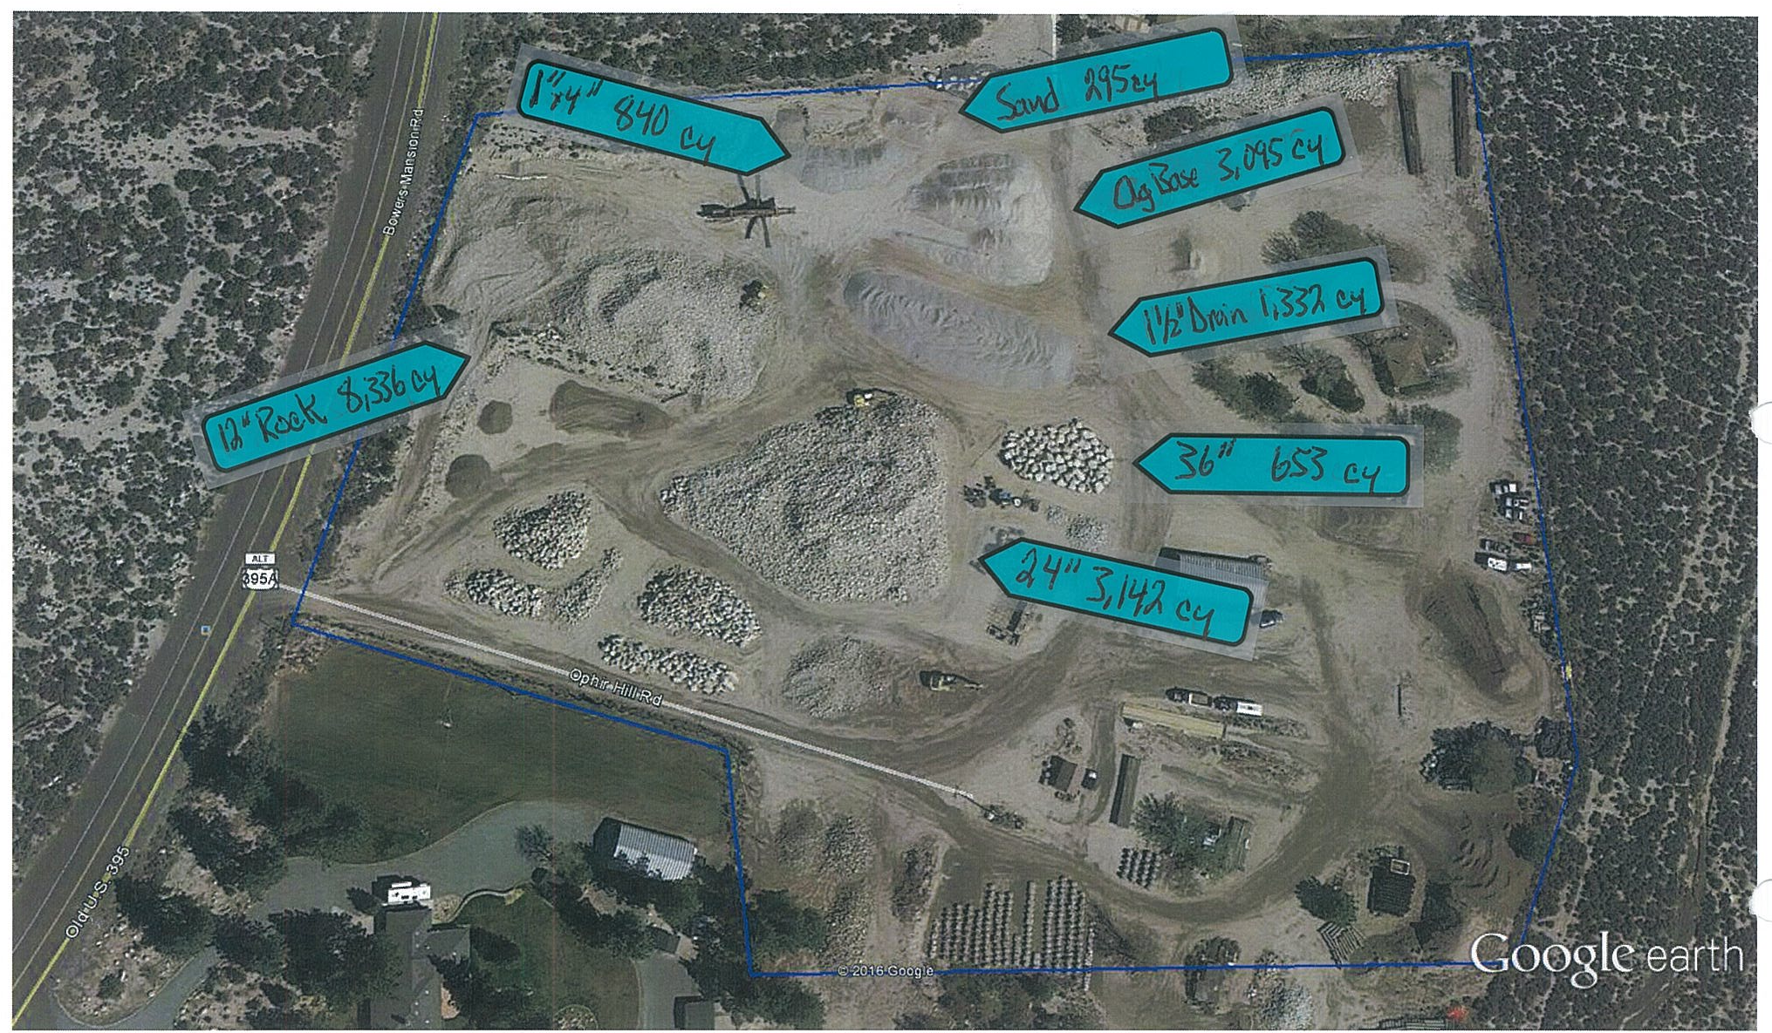
Existing Site Conditions

Slide 12
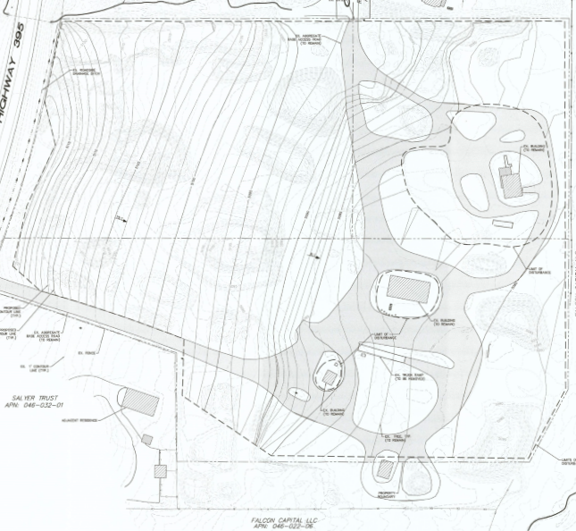
Site Plan
Limits of disturbance (dotted lines)
Proposed re-contouring
Re-graded site will slope gradually down from Hwy.395
Approx. 30 feet of elevation drop over the 11.35 acre site
Large materials to be removed
Proposed contours

Slide 13
Project Evaluation
The Conditions of Approval for the grading SUP will be used to implement the code compliance “plan”
Conditions of Approval will also address on-going operational parameters, such as:
Operations limited to daylight hours (no lighting, cannot start earlier than 6 a.m.)
Crushing of rock is prohibited; dust shall be mitigated
No sub-surface or pit mining may occur
No expansion of operations
Revegetation with native seed mix required

Slide 14
Project Evaluation
No extension of the 4-year deadline for compliance will be allowed (condition of approval)
The re-grading plan will be phased and implemented as materials are being removed from the site
Only materials currently present on the site may be included in ongoing operations and compliance efforts – no new material or temporary storage
Material loads shall be tarped and/or treated for dust or loose material

Slide 15
Reviewing Agencies
Planning and Development Division
Planning
Water Rights Manager
Engineering and Capital Projects Division
Land Development
Traffic
Washoe County Health District
Air Quality
Vector-Borne Diseases Division
Environmental Health Division
Truckee Meadows Fire Protection District
Regional Transportation Commission
Nevada Department of Transportation (NDOT)
Nevada Department of Environmental Protection (NDEP)
Bureau of Land Management, Nevada State Office
Washoe-Storey Conservation District

Slide 16
Reviewing Agencies
3 out of the 13 reviewing agencies noticed requested conditions of approval:
Planning and Development
Engineering and Capitol Projects Division, Land Development
Washoe County Health District, Environmental Health Division
See Exhibit A of the staff report for the recommended conditions of approval

Slide 17
Citizen Advisory Board/Public Comment
The South Truckee Meadows/Washoe Valley Citizen Advisory Board (STM/WV CAB) voted unanimously to recommend approval
Staff received one comment from a West Washoe Valley property owner requesting that no extension of the 4-year compliance timeframe be allowed (see condition f.2)

Slide 18
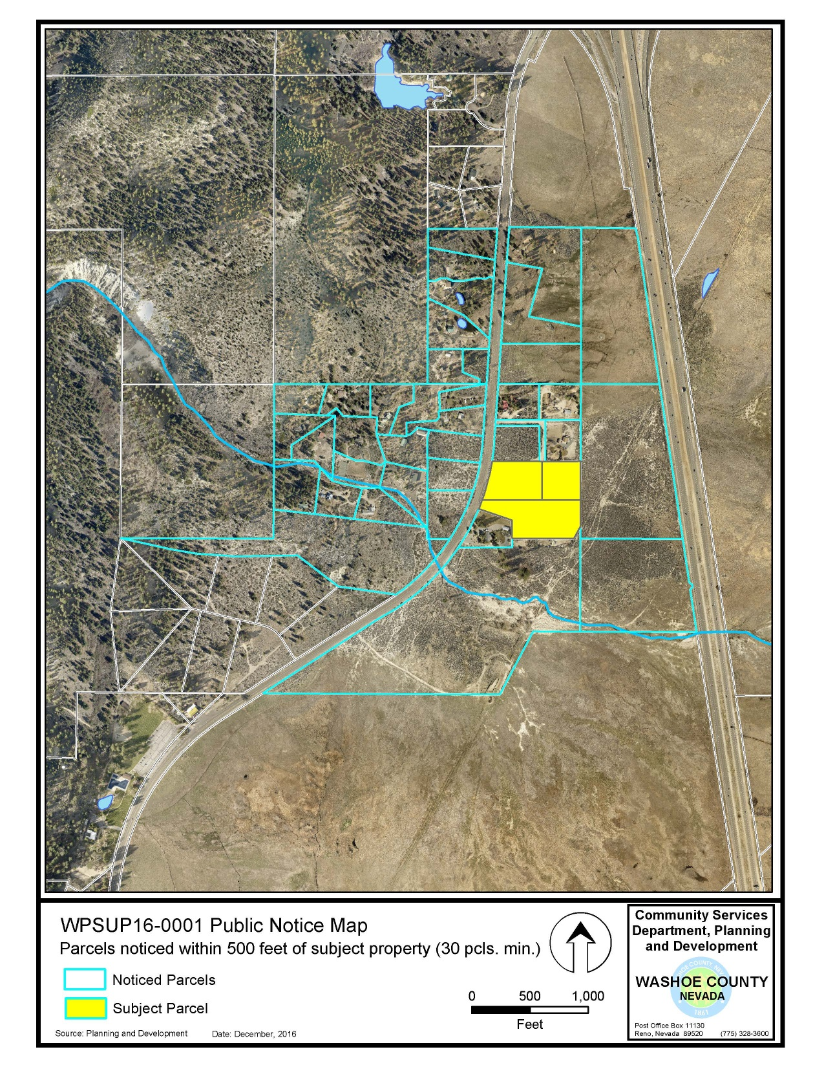

Slide 19
Required Findings
WCC Section 110.810.30, Special Use Permit Findings:
Consistency with Master Plan
Adequate Improvements
Site Suitability
Issuance Not Detrimental
Effect on Military Installation)

Slide 20
Required Findings
Staff analysis is provided in the staff report starting on page 11
Staff is able to make all of the required findings

Slide 21
Staff Recommendation
After a thorough analysis and review, Special Use Permit Case Number WSUP16-0001 for Burdick Excavating Co. (Ophir Hill) is being recommended for approval with conditions.

Slide 22
Possible Motion
I move that, after considering the information contained within the staff report and the information received during the public hearing, the Washoe County Board of Adjustment approve, with the conditions included at Exhibit A to the staff report for this item, Special Use Permit Case Number WSUP16-0001 for Burdick Excavating (Ophir Hill), being able to make the findings required by Washoe County Code Section 110.810.30 for approval of Special Use Permits.

Slide 23
Appeal Process
Board of Adjustment action will be effective 10 calendar days after the written decision is filed with the Secretary to the Board of Adjustment and mailed to the applicant, unless the action is appealed to the Washoe County Board of County Commissioners, in which case the outcome of the appeal shall be determined by the Washoe County Board of County Commissioners. Any appeal must be filed in writing with the Planning and Development Division within 10 calendar days after the written decision is signed by and filed with the Secretary to the Board of Adjustment, and mailed to the applicant.

